Slide 1

Customer Shopping Behavior Analysis
Uncovering insights from 3,900 purchases to guide strategic business decisions through data-driven analysis of spending patterns, customer segments, and product preferences.

Slide 2

DATASET OVERVIEW
The Foundation: Our Data
Our analysis draws from a comprehensive dataset of 3,900 customer transactions spanning multiple product categories. The data captures rich customer demographics, purchase details, and shopping behavior patterns.
3,900
Key features include customer age, gender, location, subscription status, item details, purchase amounts, seasonal trends, and shipping preferences. With only 37 missing values in review ratings, the dataset provides a robust foundation for analysis.
Total Purchases
18
Data Columns
50
Locations

Slide 3

Data Preparation & Cleaning
We began with comprehensive data preparation using Python and pandas. Initial exploration revealed the dataset structure and summary statistics, guiding our cleaning strategy.
01
Data Loading & Exploration
Imported dataset and examined structure using df.info() and .describe() for summary statistics
02
Missing Data Handling
Imputed 37 missing review ratings using median rating by product category
03
Feature Engineering
Created age_group bins and purchase_frequency_days columns for deeper analysis
04
Database Integration
Connected to PostgreSQL and loaded cleaned data for SQL analysis

Slide 4


KEY METRICS
Customer Demographics at a Glance
The customer base skews male at 68%, with 2,652 male customers compared to 1,248 female customers. Subscription adoption stands at 27% with 1,053 subscribers versus 2,847 non-subscribers.
Average customer age is 44 years, ranging from 18 to 70. The median purchase amount is $60, with purchases spanning from $20 to $100. Average review rating sits at 3.75 out of 5 stars.
68%
Male Customers
Dominant customer segment
27%
Subscribers
Active subscription base

Slide 5
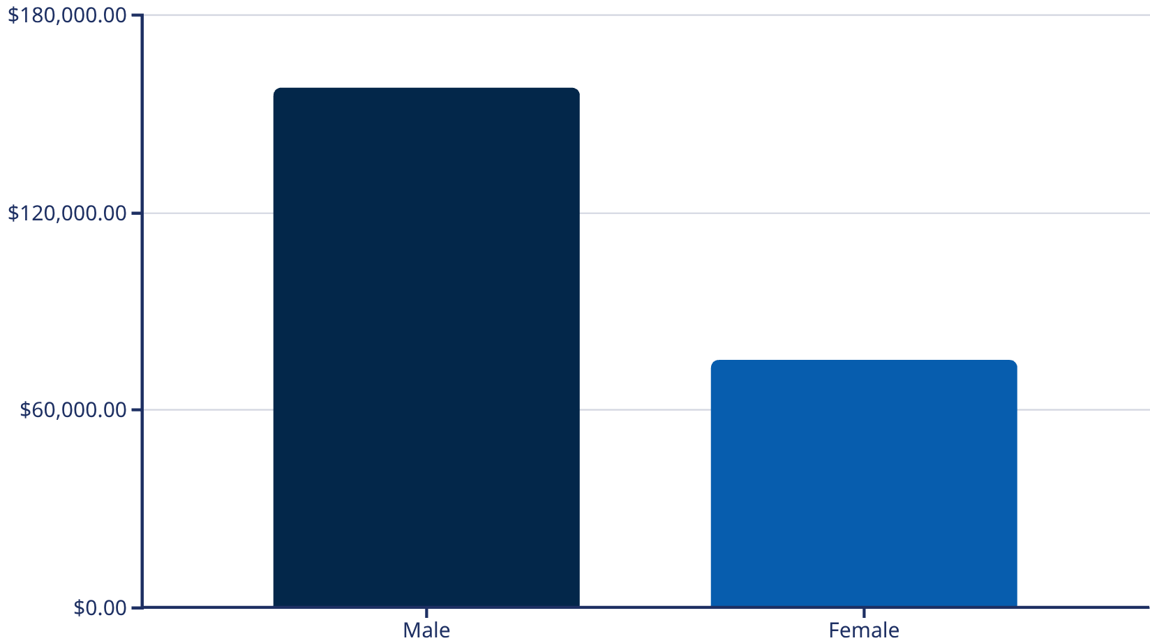
Revenue Insights: Gender & Spending Patterns
Male Customers Drive Revenue
Male customers generate $157,890 in total revenue, more than double the $75,191 from female customers. This 68% male customer base represents a significant revenue concentration.
We identified 839 high-value discount users who spent above the $60 average despite using discounts, indicating price-conscious customers who still maintain healthy purchase amounts.

Slide 6
Top-Rated Products
Customer satisfaction varies across product categories, with accessories leading in review ratings. Understanding which products resonate most helps guide inventory and marketing decisions.
Gloves
Sandals
Boots
Hat
3.86 rating
3.84 rating
3.82 rating
3.80 rating
Skirt
3.78 rating

Slide 7

Customer Segmentation Analysis
Segment Breakdown
Our customer base is dominated by loyal customers at 80%, representing 3,116 shoppers with consistent purchase history. Returning customers make up 18% with 701 individuals, while new customers represent just 2% at 83 people.
3,116
Among repeat buyers with more than 5 purchases, 958 are subscribers while 2,518 are not, suggesting significant opportunity to convert loyal customers into subscription members.
Loyal Customers
701
Returning
83
New

Slide 8
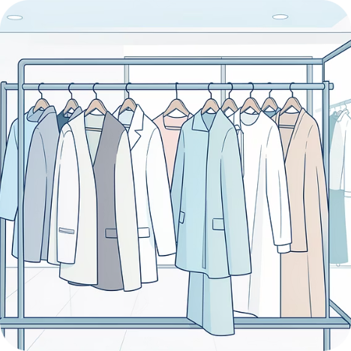

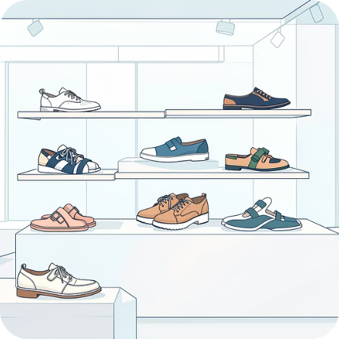
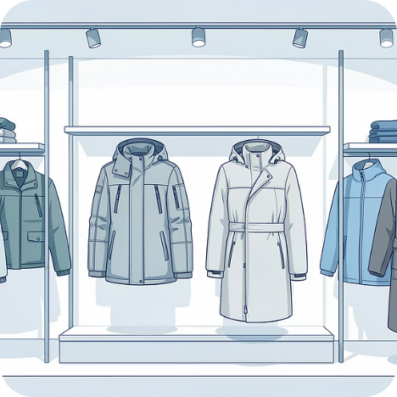
CATEGORY PERFORMANCE
Revenue & Sales by Category
Revenue Leaders
Sales Volume
Clothing dominates with $100K in revenue, followed by Accessories at $70K. Footwear contributes $30K while Outerwear rounds out at $20K.
Clothing leads with 2,000 sales (1,737 transactions), Accessories follows with 1,500 sales, Footwear at 700, and Outerwear at 400 sales.
Clothing
Accessories
Footwear
Outerwear
Top performers: Blouse, Pants, Shirt
Top performers: Jewelry, Sunglasses, Belt
Top performers: Sandals, Shoes, Sneakers
Top performers: Jacket, Coat

Slide 9
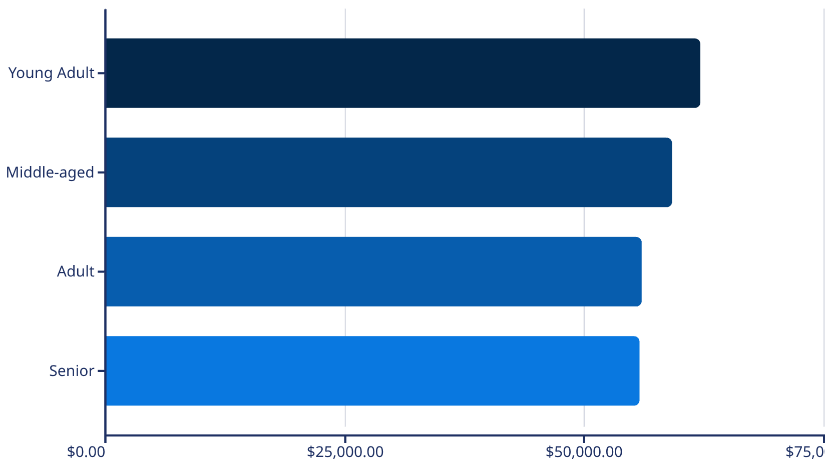
Age Group Revenue Distribution
Balanced Revenue Across Ages
Revenue distribution is remarkably balanced across age groups. Young Adults lead slightly at $62,143, followed closely by Middle-aged customers at $59,197.
Adults contribute $55,978 while Seniors generate $55,763. This even distribution suggests broad market appeal and opportunities across all demographic segments.
Express shipping users show slightly higher average spend at $60.48 versus $58.46 for standard shipping, indicating premium service preference among higher-value customers.

Slide 10
STRATEGIC RECOMMENDATIONS
Key Business Recommendations
Boost Subscription Adoption
Enhance Loyalty Programs
Optimize Discount Strategy
With only 27% subscribers but 80% loyal customers, promote exclusive benefits to convert repeat buyers into subscription members.
Reward the 3,116 loyal customers with tiered benefits to increase retention and lifetime value.
Review discount policy for products like Hats (50% discount rate) and Sneakers (49.66%) to balance sales growth with margin protection.
Leverage Top Products
Target High-Value Segments
Highlight top-rated items (Gloves, Sandals, Boots) and best-sellers (Blouse, Jewelry, Jacket) in marketing campaigns.
Focus marketing on Young Adults and express shipping users who demonstrate higher spending patterns.

